Slide 1
Linters &
Style Checkers
Morgan Blanck

Slide 2
Agenda
Introduction
History
Demo
Potential Usage in Capstone Projects
Summary

Slide 3
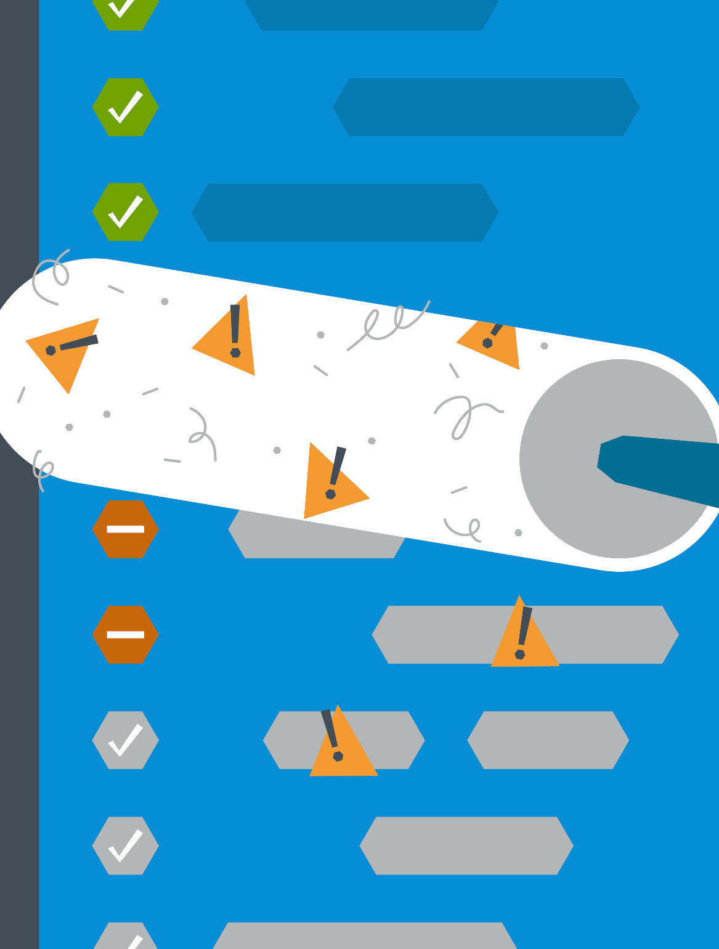
Introduction
Linters
developer tool that analyzes code for errors, vulnerabilities, and stylistic issues to improve code quality
compares code to a set of rules and notifies the user when the code deviates from these rules
Style Checkers
parse code and diagnose violations of predefined style rules
consistent style makes programmers more productive by preventing guesswork and knowing where to look and what to expect
enforcing standards can help avoid errors
https://www.honeycomb.io/blog/making-room-for-lint

Slide 4
History
Linters
Style Checkers
the term “linter” comes from a tool known as “lint”, which was developed by Stephen C. Johson in 1978 at Bell Labs
this tool was originally developed for analyzing C code
now linters are available for almost all programming languages
the first style checker was developed in 2001 by Oliver Burn
this tool, known as Checkstyle, is a code analysis tool that is used for maintaining standards for Java code
there are now many different types of style checkers that can be used for almost all programming languages

Slide 5
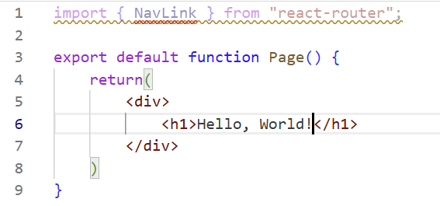
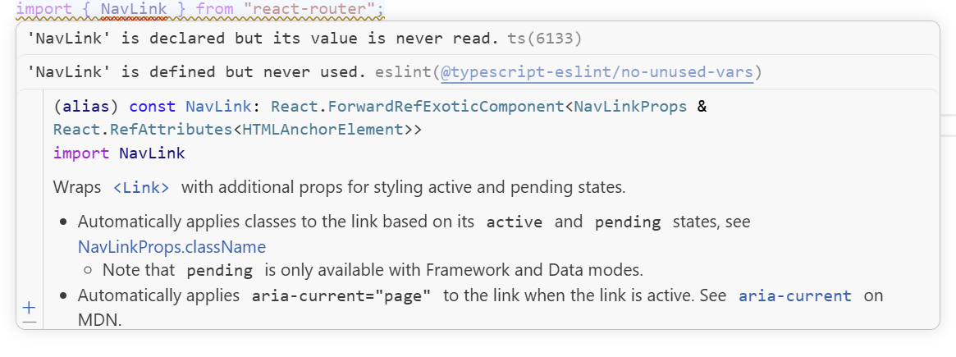
Demo: ESLint
parsing source code: linter breaks down the code into tokens (basic elements of programming languages)
  the tokens build an Abstract Syntax Tree (AST)
  checks the analyzed code against a set of guidelines and standards
reporting issues: when the linter identifies a rule violation or suspect pattern, it flags the user
  provides details (line numbers, type of issue, possible fixes) to help the developer examine the issue

Slide 6
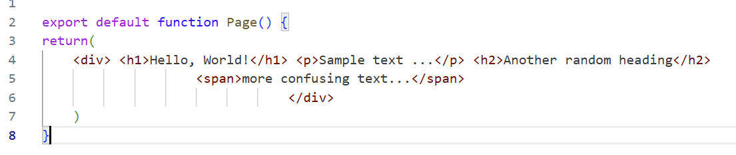
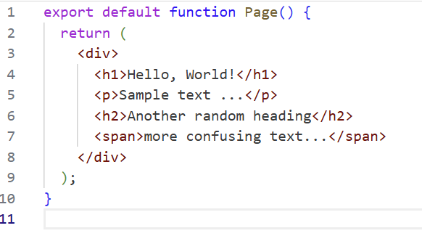
Demo: Prettier
the developer writes their code according to any style convention they choose
run Prettier from the command line with these commands:
  npx prettier [options] [file/dir …]
  ex: npx prettier –write .
  the –write flag overwrites existing files with the formatted code
  the . Targets the current directory and subdirectories
Prettier will reprint the code to enforce a consist style
does not affect the behavior of the code

Slide 7
Potential Uses in Capstone Projects
Linters
Style Checkers
Language Agnostic:
MegaLinter
Go:
golint
JavaScript:
eslint
TypeScript:
tslint
Python:
pylint
Prettier: supports JavaScript, TypeScript, HTML, CSS, and more
Pylint: enforces code standards and flags code smells, in addition to checking for errors
Checkstyle: used for enforcing code standards in Java
.NET code style analysis

Slide 8


Summary
Linters:
a developer tool that improves code quality by analyzing code for errors, vulnerabilities, and stylistic issues
Style Checkers:
enforce a consistent style by detecting violations of predefined style rules
makes programmers more productive
enforcing standards can help avoid errors

Slide 9
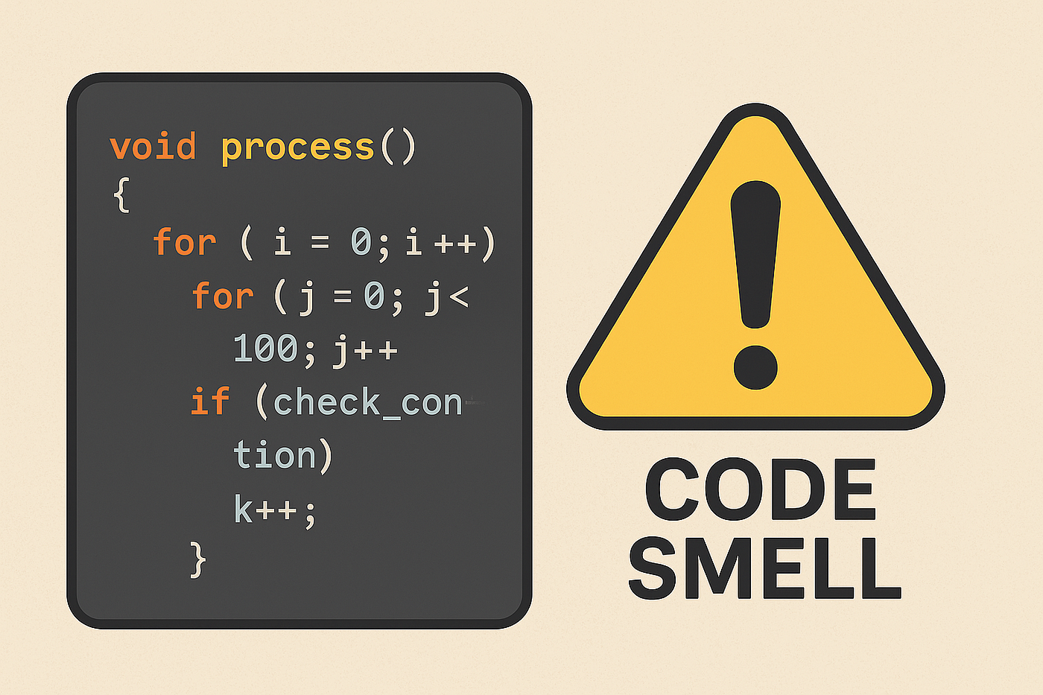
References
https://www.sonarsource.com/resources/library/linter/
https://www.semanticdesigns.com/Products/StyleChecker/
https://en.wikipedia.org/wiki/Checkstyle

